Slide 1
RECAP OF THE WORK DONE

Slide 2
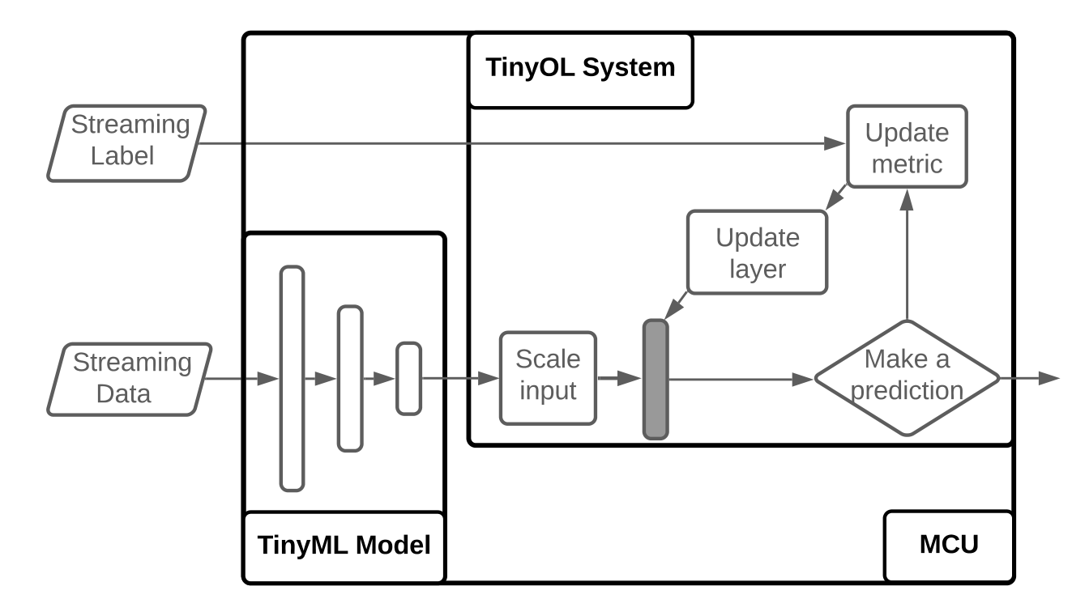
ORIGINAL IDEA
From the paper “TinyOL: TinyML with Online-Learning on Microcontrollers” the idea is to implement a similar system that can later be applied on a different application. The objective is to create a framework to be deployed on a microcontroller where continuous learning is performed.

Slide 3




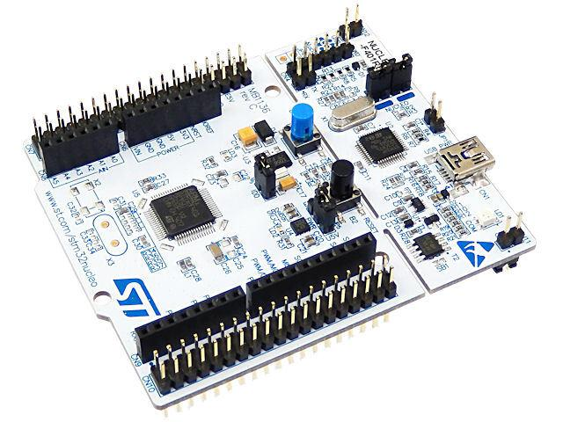

IDEA OF THE PROJECT
Collect a dataset of letters written in the air (accelerometer data)
Train a model for classification
Create a deployable model for the STM
Deploy the model on the STM NUCLEO board
Perform continual learning on the microcontroller
Perform inference
Perform fine tuning of the old layers
Train the model on new data
Old data
New data

Slide 4


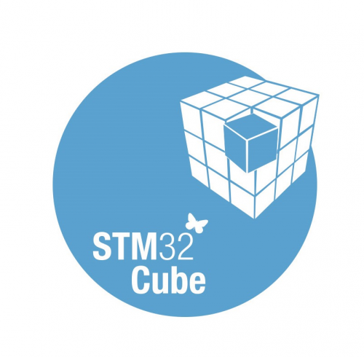

MY IMPLEMENTATION
The initial code is developed on the laptop (Tensorflow + Jupyter + Python)
Later the same code has been ported on the STM NUCLEO

Slide 5
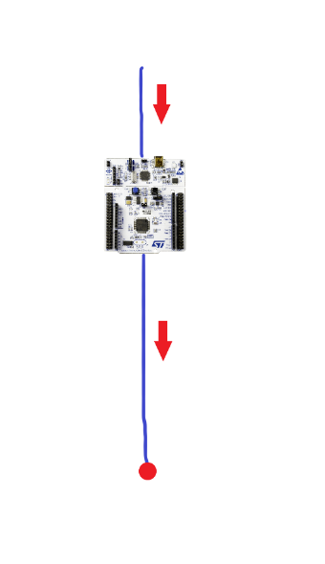
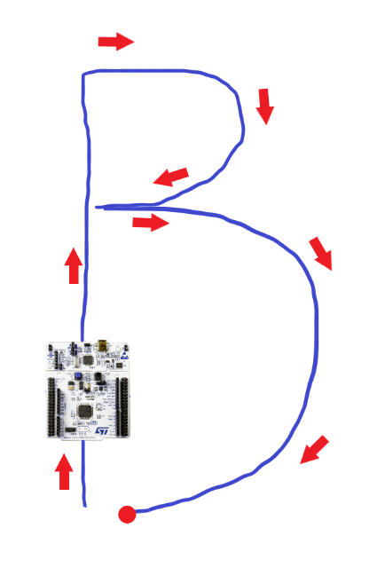
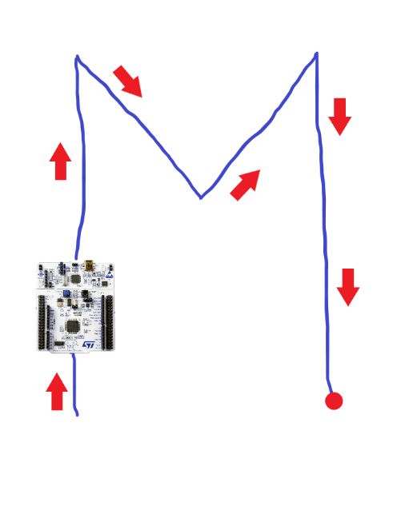
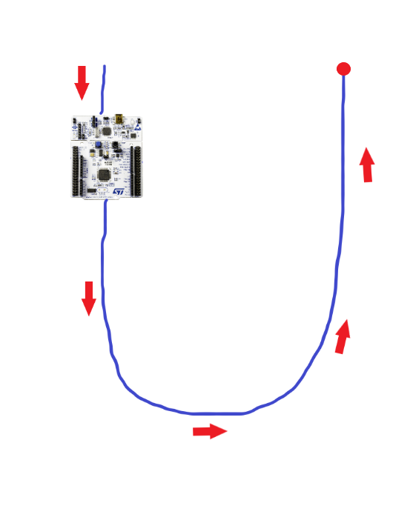
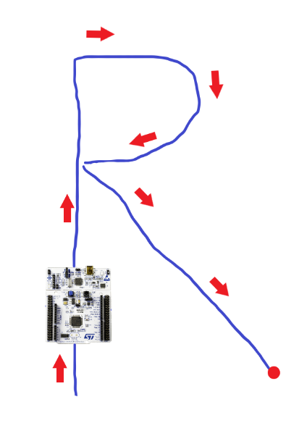
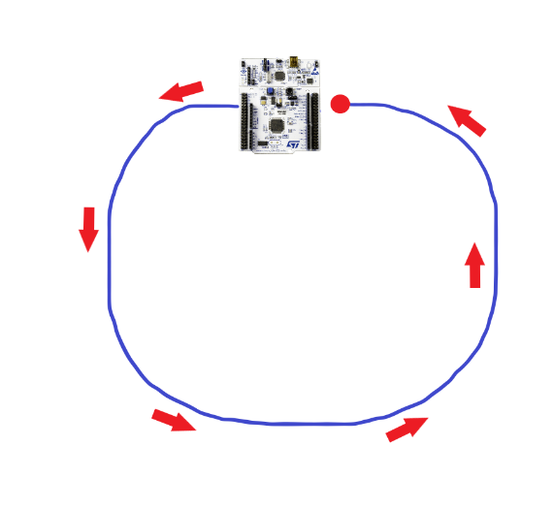
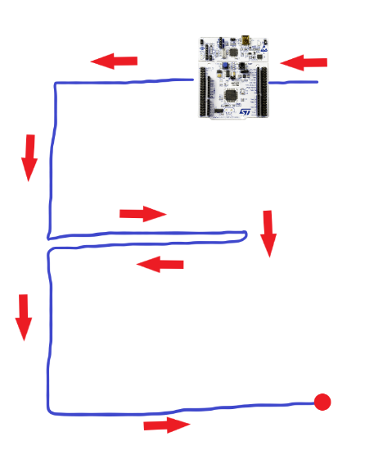
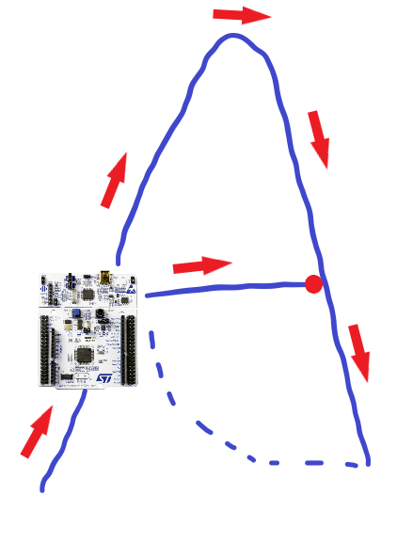
DATASET PREPARATION
DATA
The ML model is based on an example seen during lecture. The model recognizes letters written in the air using the accelerometer information.
LETTERS IN THE DATASET
A - E - I - O - U - B - M - R

Slide 6

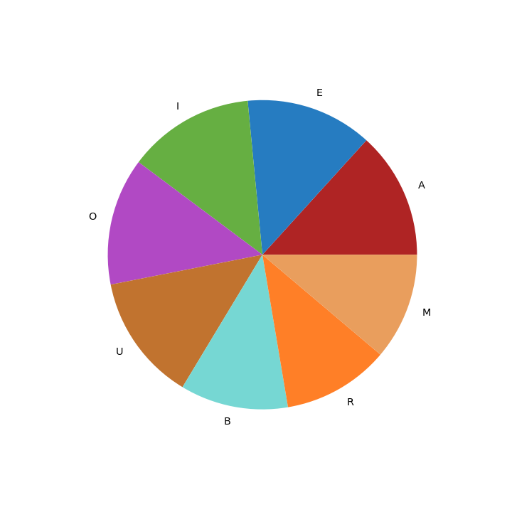
DATASET COMPOSITION
The entire dataset is composed of 8 letters:
A: 230 samples
E: 230 samples
I: 230 samples
U: 230 samples
O: 230 samples
B: 197 samples
R: 195 samples
M: 195 samples
Total is of 1737 samples

Slide 7
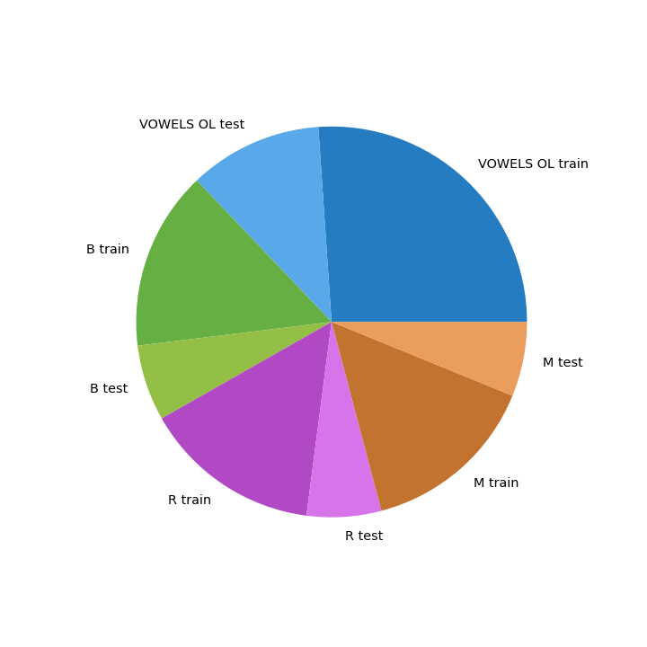
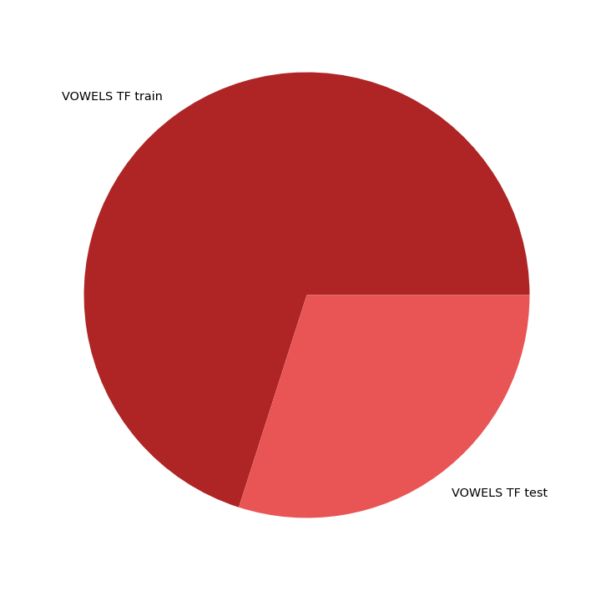
DATASET COMPOSITION
Training of the frozen model. Only vowels
Train -> 563 elements
Test - > 240 elements
Training of the OL layer. Vowels +R + B + M
Train -> 652 elements (137 x 3 + 241)
Test -> 276 elements (58 x 3 + 102)

Slide 8
REAL LIFE SCENARIOS
There are mainly 3 scenarios in which Continuous Learning can be applied:
New Instances (NI): when the model is subjected only to new samples of already known classes
New Classes (NC): when the model is subjected only to new samples belonging to new classes
New Instances and Classes (NIC): when the model is subjected to both new samples of already known classes and new samples of new classes
The closest to real life

Slide 9
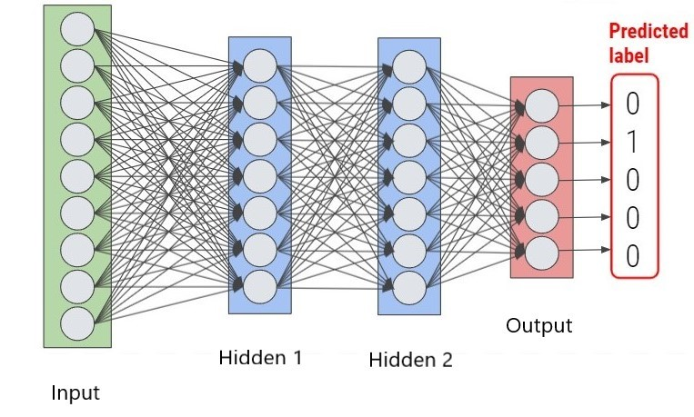
CREATION OF THE MODEL
The frozen model is based on an example seen during lecture. The model structure is:
Input layer: 600 nodes
Hidden layer 1: 128 nodes
Hidden layer 2: 128 nodes
Output layer: 5 nodes
The model is trained with keras for 40 epochs.

Slide 10
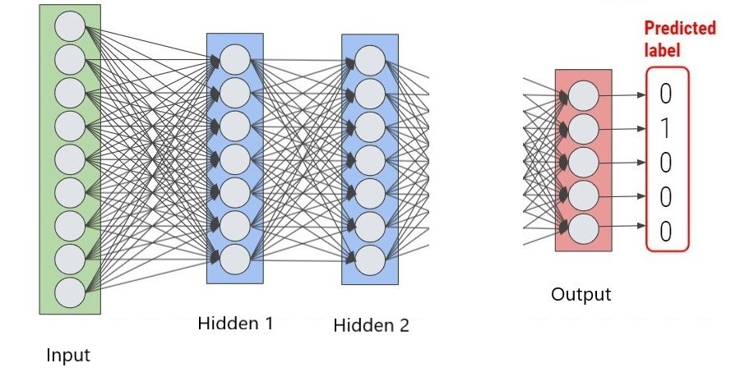
CREATION OF FROZEN MODEL & OL LAYER
The idea is to split the keras model in two parts. The Frozen model and the OL layer (last layer)
The model.h5 allows me to make easy prediction with X-CUBE-AI
The matrix and array stored in this way allow me to modify manually each weight easily
Save this part as a matrix and array write file -> layer_weights.h
Save this part as a keras model -> model.h5

Slide 11
STRUCTURE OF OL LAYER
Output from Frozen model
Array of biases
Prediction
Matrix of weights
W_{0,0}
W_{0,1}
....
W_{0,127}
B₀
W_{1,0}
W_{1,1}
....
W_{1,127}
B₁
W_{2,0}
W_{2,1}
....
.
+
=
Softmax
W_{2,127}
B₂
W_{3,0}
W_{3,1}
....
W_{3,127}
B₃
W_{4,0}
W_{4,1}
....
W_{4,127}
B₄
TinyOL Layer

Slide 12
CONCATENATION OF ML AND TinyOL
Prediction
True label
TinyOL Layer
Frozen ML model
Update weights

Slide 13
HOW TO CONTRAST FORGETTING
ALGORITHMS AND THEIR IMPLEMENTATION

Slide 14
CATASTROPHIC FORGETTING
When continuous learning is applied, catastrophic forgetting can be a problem. This consists in a behaviour that brings the model to forget old classes on which it was previously trained.To avoid this, some methods can be implemented:
OL: basic implementation of a training of a model
OL v2: simple modification of the already implemented method
LWF: learn without forgetting
CWR: copy weight with reinit

Slide 15
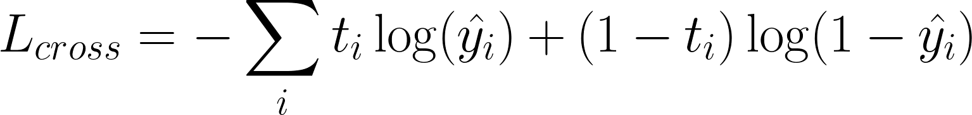
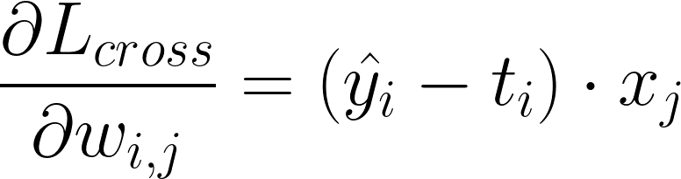
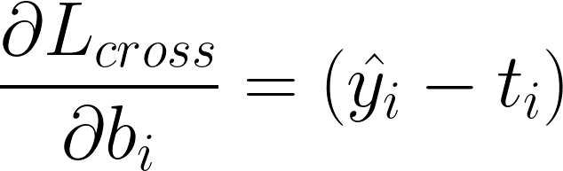
OL IMPLEMENTATION
IDEA
Use the cross entropy as the cost function and update the weights using a gradient descend applied on the softmax layer. When a new letter is found increase the dimension of the weights matrix and biases array.
WEIGHTS AND BIASES UPDATE RULE

Slide 16
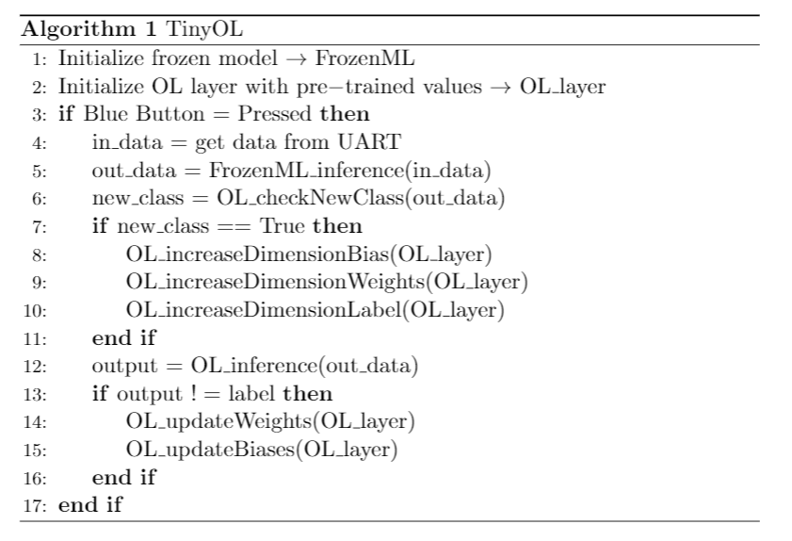
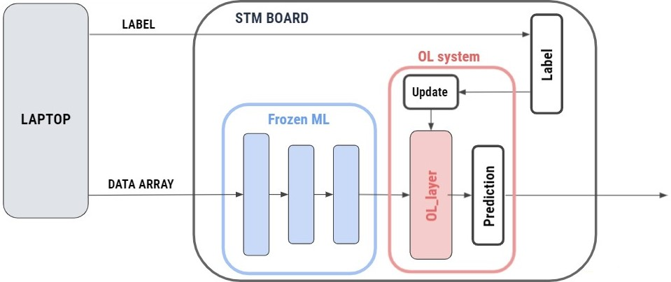
APPLY ALGORITHM ON STM

Slide 17
Versione CUBE-MX-AI v.6
STM BOARD
LABEL
OL system
Label
Update
LAPTOP
Frozen ML
DATA ARRAY
OL_layer
Prediction

Slide 18
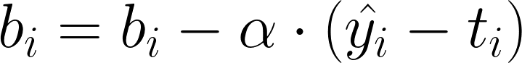
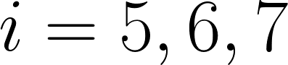
OL v2 IMPLEMENTATION
IDEA
Use the already implemented OL method. Update the weights following the classical Crossentropy Loss function. This time the weights that are updated are only the new classes. VOWELS ARE NOT UPDATED
(Meaning that only B, R, M weights are updated)

Slide 19
Label
Label
Update
OL layer
Frozen ML
.
+
Prediction
Data array
TinyOL system

Slide 20
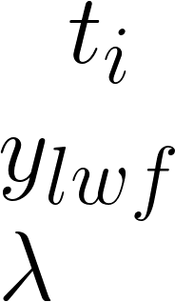
LWF IMPLEMENTATION
IDEA the loss functions considers 2 scores
Error committed by the prediction
Error committed w.r.t. the original weights
Current error
Error w.r.t. original weights
Where:
= true label of the input data
= prediction performed by the model with original weights
= weight in between 0 and 1

Slide 21
LWF CONCLUSION
In this case the UPDATES for the weights and biases become:
PROS: very simple to implement
CONS: Requires 2 matrix of weights. Each prediction is in fact twice the computation

Slide 22
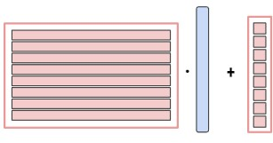
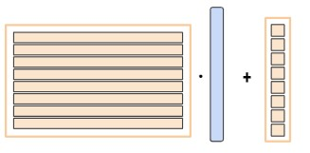
Label
Update
Label
OL layer
Frozen ML
Prediction
Data array
Original layer
Batch predictions with original weights
TinyOL system

Slide 23
CWR IMPLEMENTATION
Create two sets of weights,TW and CW
TEMPORAL WEIGHTS - TW
Short term memory weights
Used to perform training
Continuosly modified during a batch (each time are initialized to 0)
CONSOLIDATED WEIGHTS - CW
Long term memory weights
Used to perform inference
Modified only at the end of the batch (weighted average between CW and TW)

Slide 24
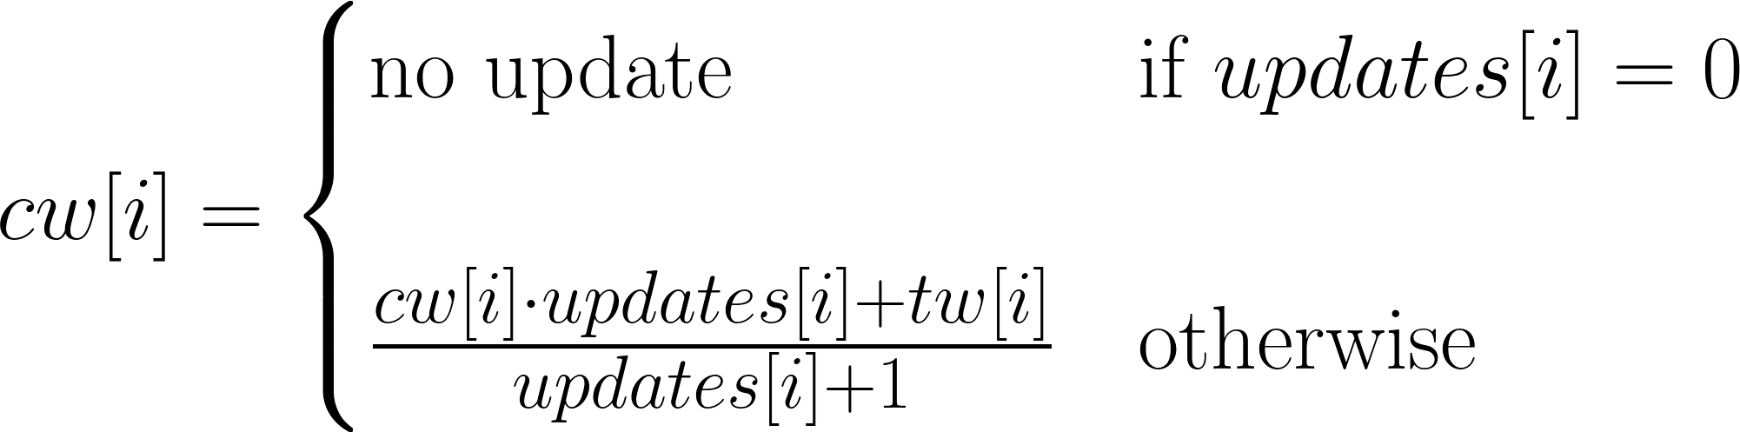
CWR CONCLUSIONS
The weight update CW after each batch follows the rule:
Where updates is a vector that, in each place, contains the number of letters found in a batch
PROS: easy to implement
CONS: Can work only with mini batches. Requires the storing of 2 matrices of same dimension

Slide 25
TRAINING PHASE
INFERENCE PHASE
* init with pre trained weights
CW
Prediction
Frozen ML
Data array
When batch end
Update
TW
Prediction
* init with zeros
Update
TinyOL system
Label
Label

Slide 26
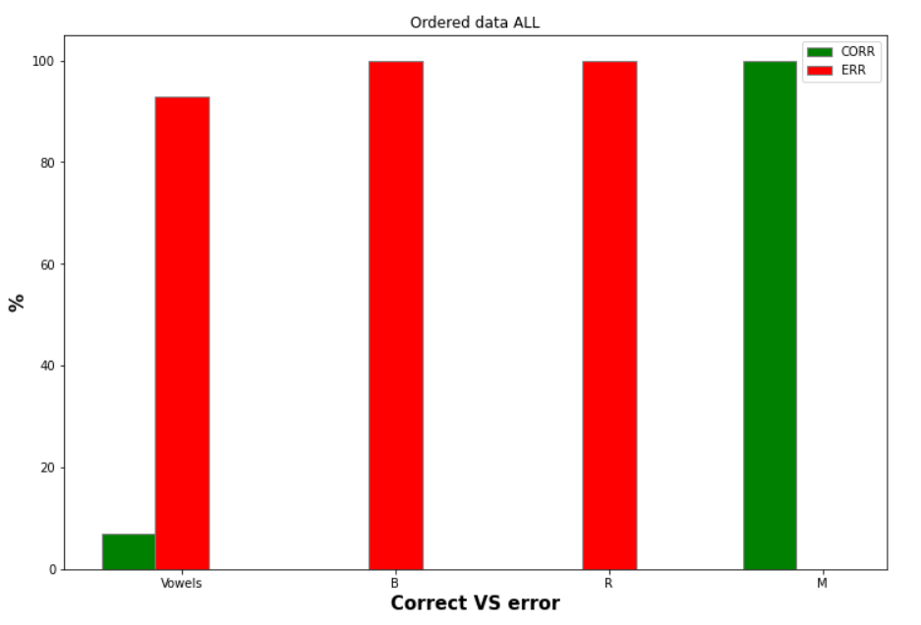
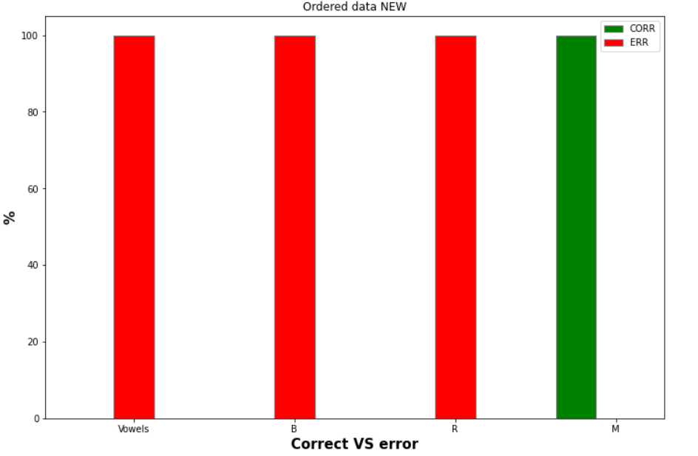
COMPARISON DATA - ORDER vs MIXED
Does the order of the training data matter? If the training is performed on data of only the letter A, then letter E, then letter I, … then letter M. Is it able to learn the classification anyways?
ORDER OF DATA VOWELS, B, R, M
RESULT forgets almost everything, learns M
ORDER OF DATA B, R, M
RESULT forgets everything, learns M

Slide 27
DATA ORDER CONCLUSIONS
CONCLUSION
Ordered data -> bad performance
Model performs bad -> forgets everything previously, learns only the last class
Mixed data -> good performance
Model performs good -> by having mixed data the learning is refreshed every time
It is closer to a real life application scenario

Slide 28
RESULTS COMPARISON
SIMULATION vs APPLICATION

Slide 29
TRAINING SET UP
Both are trained on 767 samples
Bot simulation and application are tested on 330 samples. Simulation performs only prediction, application performs also training.
All the learning rates have been manually fine tuned

Slide 30
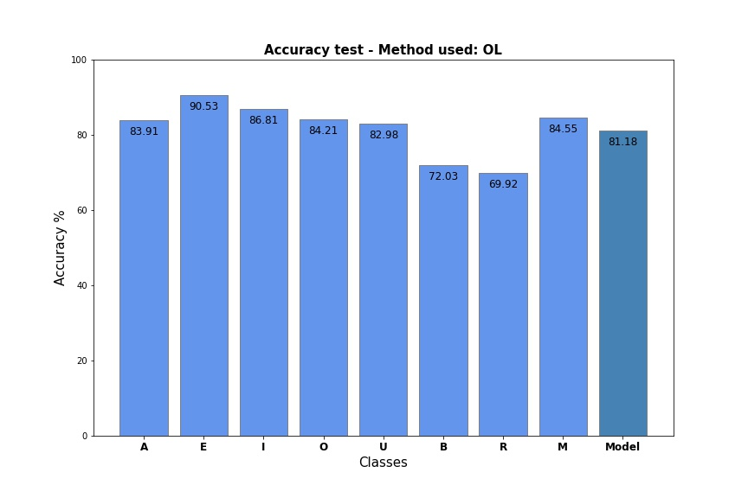
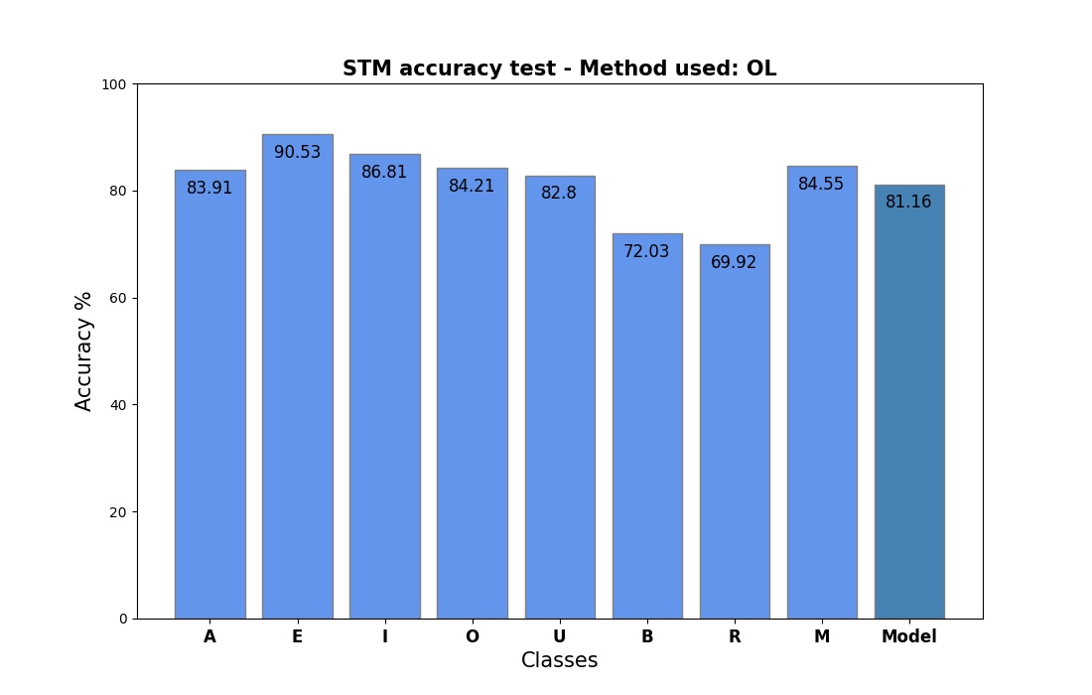
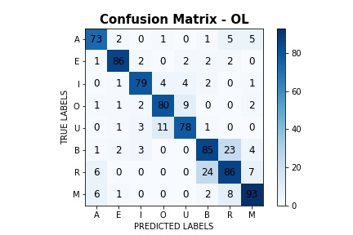
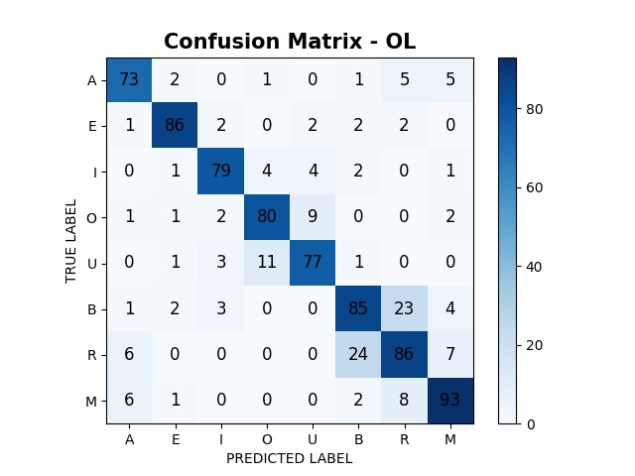
COMPARISON - METHOD OL
SIMULATION ON LAPTOP
APPLICATION ON STM

Slide 31
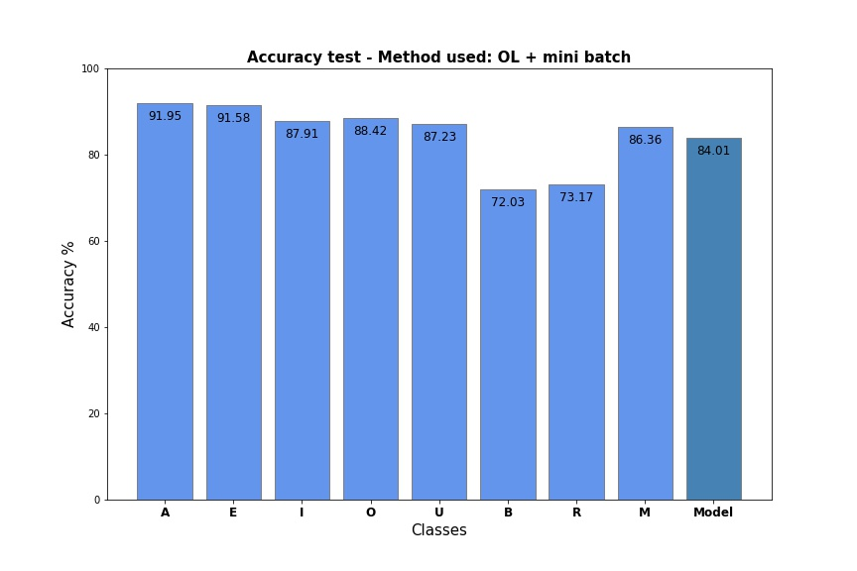
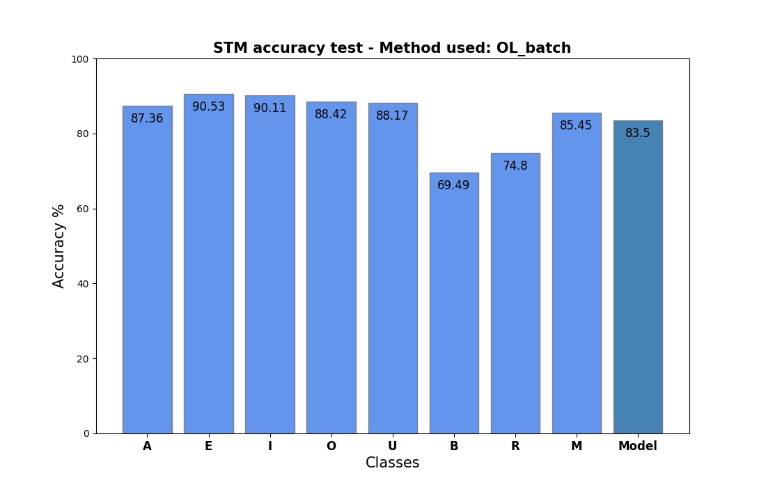
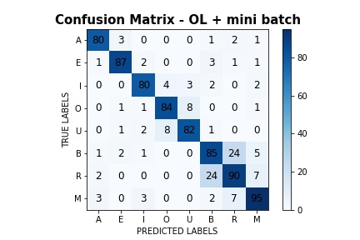
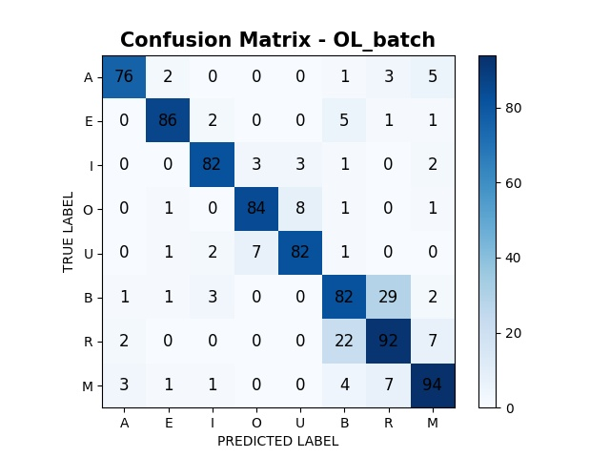
COMPARISON - METHOD OL mini batches
SIMULATION ON LAPTOP
APPLICATION ON STM

Slide 32
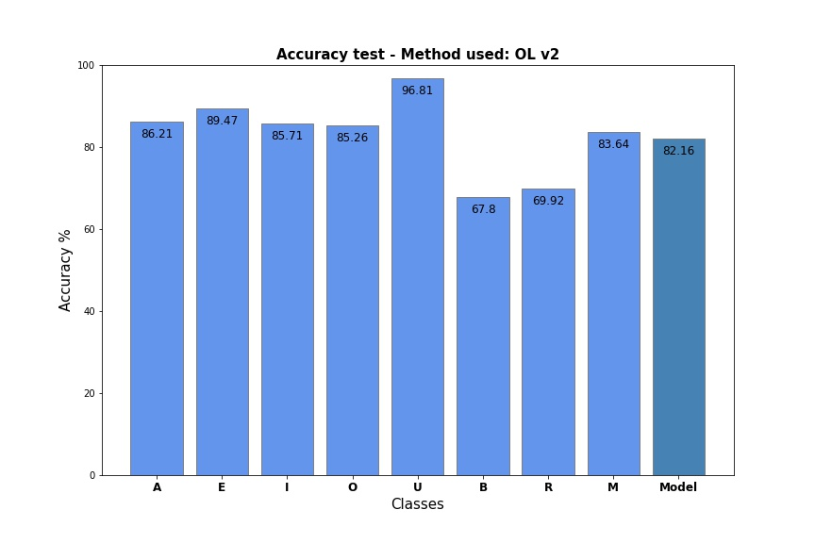
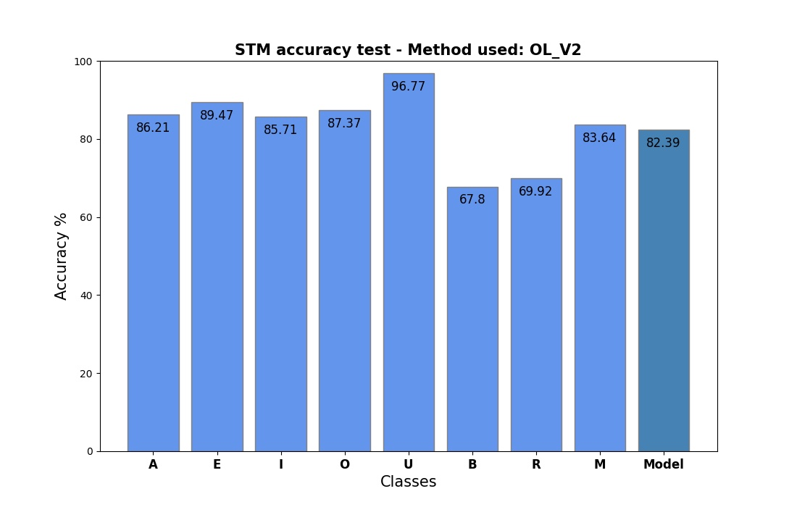
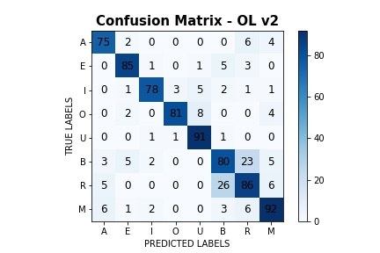

COMPARISON - METHOD OLv2
SIMULATION ON LAPTOP
APPLICATION ON STM

Slide 33
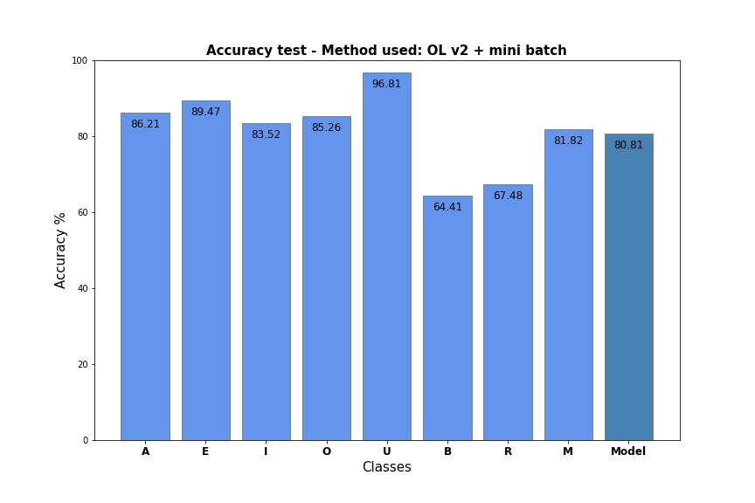

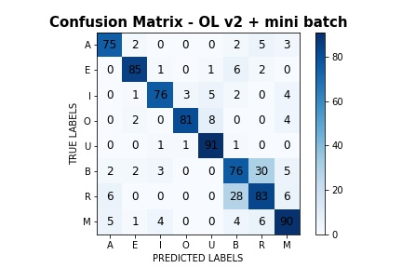
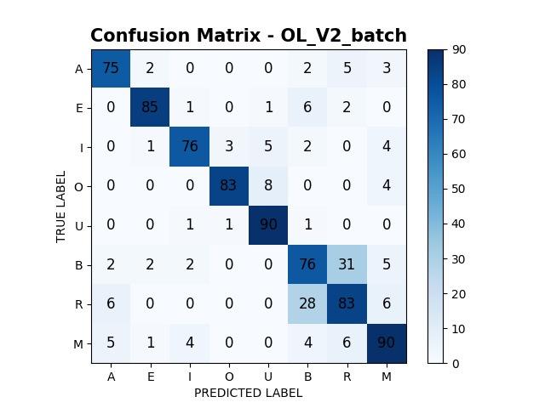
COMPARISON - METHOD OLv2 mini batches
SIMULATION ON LAPTOP
APPLICATION ON STM

Slide 34
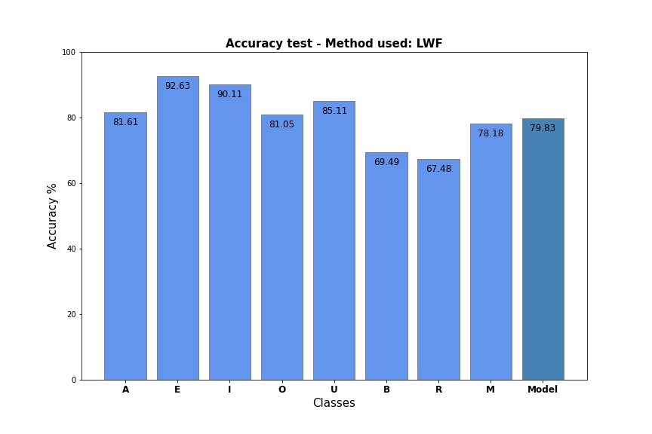

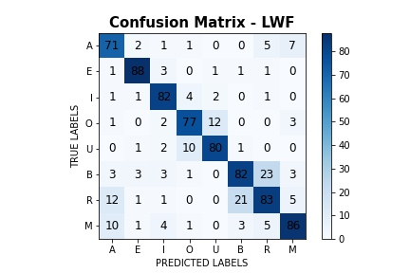

COMPARISON - METHOD LWF
SIMULATION ON LAPTOP
APPLICATION ON STM

Slide 35
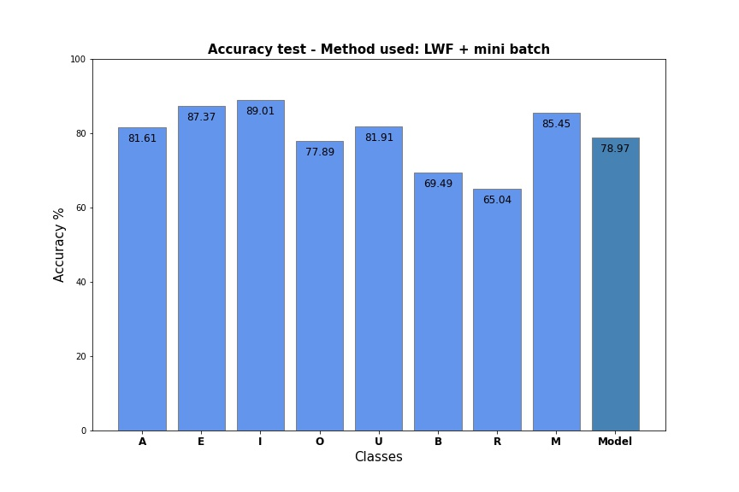
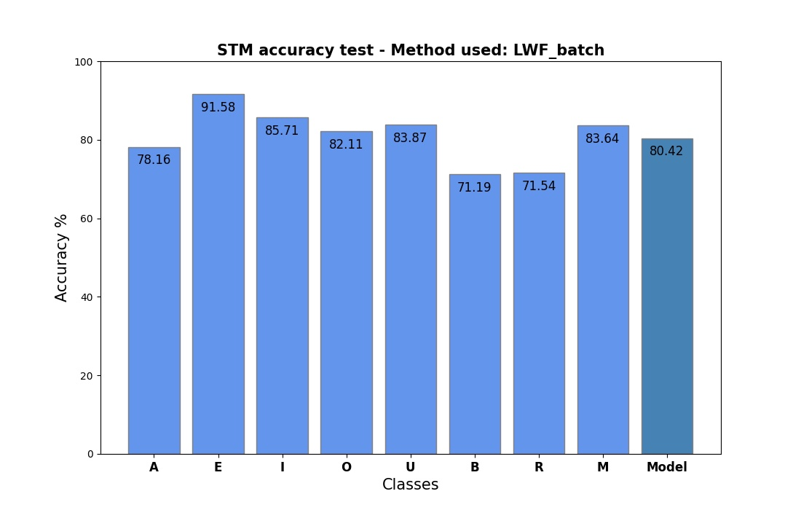
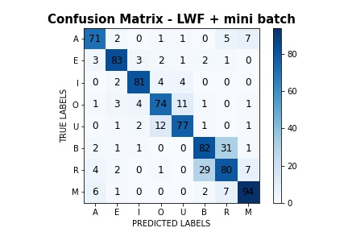

COMPARISON - METHOD LWF mini batches
SIMULATION ON LAPTOP
APPLICATION ON STM

Slide 36

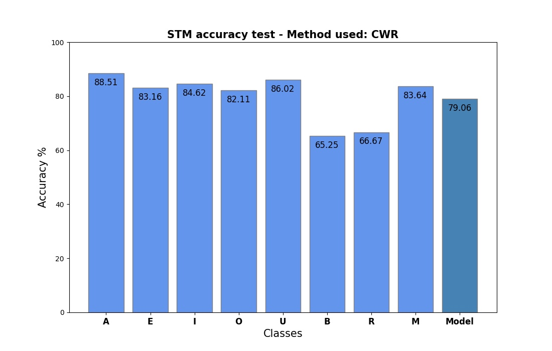
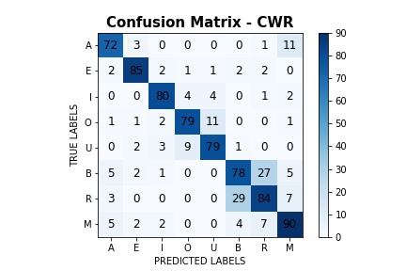

COMPARISON - METHOD CWR
SIMULATION ON LAPTOP
APPLICATION ON STM

Slide 37

RESULTS OF THE APPLICATION ON STM
Size of RAM is 96kB

Slide 38
CONCLUSIONS
The simulation on the laptop and the application on the STM are basically the same
Overall, both show good results and are able to learn all the new classes

Slide 39
DEBUGGING OF THE DIFFERENCES
SIMULATION vs APPLICATION

Slide 40
SET UP OF CONTROLLED DATASET
The training dataset is mixed and saved in a txt file
In both the laptop training and STM training the dataset is loaded from this txt file
Application and simulation are subjected to the same exact data in the same exact order
After some testing it turns out that the problem was the dataset itself

Slide 41

WHERE TO LOOK FOR DIFFERENCES
There are 3 places in which the output can be monitored:
1 - Immediately after the frozen model (to see the errors introduced by CUBE MX)
2 - After the softmax layer
3 - See the history of the weights and biases

Slide 42




RESULTS BEFORE THE FIX
SIMULATION ON LAPTOP
APPLICATION ON STM

Slide 43


FROZEN MODEL INVESTIGATION
COMPARISON OF FROZEN MODEL OUTPUT
The maximum difference found in all the 702 iterations is at the iteration 88
The maximum error found is of -> 0.00058872656

Slide 44




FROZEN MODEL INVESTIGATION
COMPARISON OF BIAS

Slide 45



FROZEN MODEL INVESTIGATION
COMPARISON OF WEIGHTS

Slide 46




FROZEN MODEL INVESTIGATION
COMPARISON OF SOFTMAX

Slide 47
HOW THE PROBLEM WAS SOLVED
To fix the problem the dataset has been completely replaced. The results are now the same in both the STM application and in the laptop simulation

Slide 48

FROZEN MODEL INVESTIGATION
COMPARISON OF FROZEN MODEL OUTPUT
The maximum difference found in all the 702 iterations is at the iteration 822
The maximum error found is of -> 0.00044628125

Slide 49



FROZEN MODEL INVESTIGATION
COMPARISON OF BIAS

Slide 50



FROZEN MODEL INVESTIGATION
COMPARISON OF WEIGHTS

Slide 51



FROZEN MODEL INVESTIGATION
COMPARISON OF SOFTMAX

Slide 52
FROZEN MODEL INVESTIGATION
RESULTS AFTER THE FIX
SIMULATION ON LAPTOP
APPLICATION ON STM

Slide 53






FROZEN MODEL INVESTIGATION
WHY OLD DATASET DIVERGES
I created a third dataset and tested it on new trainings on the STM and PC
CONCLUSION: there is no difference in the trainings. STM an PC behave in the same way
Softmax difference
Bias difference
Weights difference

Slide 54
FROZEN MODEL INVESTIGATION
WHY OLD DATASET DIVERGES
What I did to solve the problem:
I rewrote the code that sticks together different txt files and shuffles them
I found an error in the function (that I wrote) that sends data from the STM and the laptop
After these two changes no more divergences has been found in the evolution of the model on the STM and on the PC

Slide 55
















FROZEN MODEL INVESTIGATION
WHY OLD DATASET DIVERGES
Now 3 training applied on the three separated dataset show these results
DATASET 1
DATASET 2
DATASET 3
Biases weights
Biases weights
Biases weights

Slide 56









FROZEN MODEL INVESTIGATION
WHY OLD DATASET DIVERGES
Since now all the datasets are working properly I was able to perform a training with all the data that I collected.
The entire dataset is now composed of 4249 elements

Slide 57
OPENMV DEMO
MNIST DIGIT RECOGNITION

Slide 58


SET UP OF OPENMV APPLICATION
IDEA
Train on the laptop a model to recognize the first 6 digits of the MNIST dataset (0,1,2,3,4,5). Later deploy the model on the OpenMV and use Ol training to learn the remaining digits. This time it uses a CNN and real time data collection (images)
(For now only the code for the OL training mode is implemented)
The frozen model is trained to recognize these
The OL layer will be trained to recognize these

Slide 59




SIMULATION OF DIGIT RECOGNITION
The idea is tested again on the laptop in the same way of the letters. These are the results:
Training of frozen model
Simulation of OL training on PC

Slide 60

APPLICATION ON THE OPENMV CAMERA
SET UP OF THE TRAINING
A python app shows a new digit every 150 ms and at the same time sends the label to the OpenMV camera using the UART communication on the COM port. NB: the script has to be loaded on the camera (as a main.py file) while using the COM port and the camera cannot be connected in debug mode to the IDE
Sono stati rifatti altri video caricati sul Drive

Slide 61


NEW IMAGES ABOUT THE SET UP

Slide 62

NEW VIDEO ABOUT THE SET UP

Slide 63




APPLICATION ON THE OPENMV CAMERA
RESULTS
Training is performed on a total of 4000 images (400 for each digit). These plots represent the last 1000 results
METHOD: OL
METHOD: OL v2
Still to check why it does this
Looks like 1 gets confused with 4

Slide 64

APPLICATION ON THE OPENMV CAMERA
PROBLEMS
All the other method use double the amount of matrices. Meaning double the amount of heap space
This is a problem since the camera doesn’t allow that much memory allocation.
(when in debugging mode I try to flash the code on the camera and this error pops up, it runs until it cannot allocate memory anymore)
Heap size is -> 230 KBs
Memory needed for the matrices is circa -> 115 KBs
POSSIBLE SOLUTIONS
Optimize the code in order to use smallest amount possible of matrix (separate the matrix in arrays and use those)
Reduce dimension of matrices (matrices are 6x2028, I can reduce 2028 value but I need to modify the CNN model)

Slide 65


SOLUTION TO THE MEMORY ERROR
UPDATES
All the problems regarding the memory have been solved modifying the code and modifying the NN model
The last layer of the CNN model is now 6x512
NOW
BEFORE

Slide 66



PRUNING OF THE MODEL
PRUNING
Some models were too big to be deployed on the camera, pruning was necessary. In this case the model could be loaded bit pruning was maintained
Pruning code is taken from the example by Tensorflow
Model starts with 50% sparsity and end with 80% sparsity
Comparison of testing performance between original model and pruned model
Comparison of memory occupied by original model and pruned model

Slide 67
APPLICATION OF PRUNED CNN ON CAMERA
RESULTS
All the OL trainings are performed on 5000 images,
4000 are used only for the training
1000 are used for testing the model while training (circa 100 samples for each digit)
All methods are tested with:
Learning rate: constant and equal to 0.005
Batch size: 8
Each training takes about 10-15 minutes to complete
Here are the results…

Slide 68


APPLICATION ON CAMERA - OL

Slide 69

APPLICATION ON CAMERA - OL V2

Slide 70

APPLICATION ON CAMERA - LWF

Slide 71

APPLICATION ON CAMERA - CWR

Slide 72

APPLICATION ON CAMERA - OL BATCH

Slide 73

APPLICATION ON CAMERA - OL V2 BATCH

Slide 74

APPLICATION ON CAMERA - LWF BATCH

Slide 75
WHAT TO DO NOW
WHAT TO DO NOW ?
ABOUT THE LAB PART OF THE PROJECT
Possibly use another type of CNN, maybe a state of the art model with pruning and quantization and try to apply on camera
Add plot that shows variation of accuracy with different batch size
Implement my algorithm
ABOUT THE THESIS PART
Understand what to do with the paper already written, which conference, what to modify (introduction, conclusions are the weak parts up to now, also too few references)
How much work still to do, when is a possible date for starting to write the thesis
Define a title for the thesis (8 feb è la scadenza per il frontespizio firmato con titolo)

Slide 76



3D PRINT OF A CAMERA STAND

Slide 77
MY ALGORITHM IMPLEMENTATION
IDEA train on line 2 classifications layer at the same time and then merge them together
TL: train layer, it learns from every sample that it receives
CL: c layer, it learns only from the vowels received (fine tune)
At the end of one batch, update TL weights with a weighted average
At the end of one batch, update CL by coping TL
- At the end of one batch, update CL by coping TL
CHARACTERISTICS
Simple to implement
Depends on updated weights and old weights
Continuous update on NEW CLASSES
Refresh at each batch the OLD CLASSES
REQUIRES ALWAYS TWO PREDICTIONS (more computations)

Slide 78



Label
Prediction
Error
Data array
Label
Copy
Weighted average
Error
Prediction
If label == orignal class
OL layer

Slide 79

OPENMV APPLICATION - MY ALGORITHM

Slide 80



STM32 APPLICATION - MY ALGORITHM

Slide 81


VARIATION OF BATCH SIZE
APPLICATION ON NUCLEO STM32
APPLICATION ON OpenMV CAM
In both tests the algorithm behave in the same way:
TinyOL and TinyOL V2 -> drop in accuracy
On Nucelo, max drop is 20%
On OpenMV cam, max drop is 10%
CWR and LWF -> maintain the accuracy constant

Slide 82
APPLICATION OF OL ON SQUEEZNET
A problem has been found while applying OL system on a pre trained SQUEEZNET model:
Since the model is not created with a “sequence” tensorflow command it’s not immediate to remove the last layer in order to generate the frozen model
It’s necessary to find out how to remove the last layer, after that a quantization should be applied and everything deployed on the OpenMV camera

